Slide 1
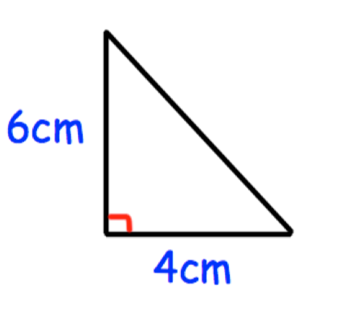
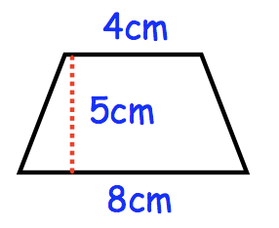
Starter – Daily 5
Calculate the missing side of the following triangle:
2. Simplify w³ x w⁵
3. Calculate the area of this trapezium:
4. Name any two of the tests for congruency of a triangle
5. Write down the formula for Pythagoras’ Theorem

Slide 2
The Theorem
https://www.youtube.com/watch?v=uaj0XcLtN5c

Slide 3
Topic: Pythagoras’ Theorem
EQ: How can I use Pythagoras’ Theorem to solve missing side lengths of a triangle?

Slide 4
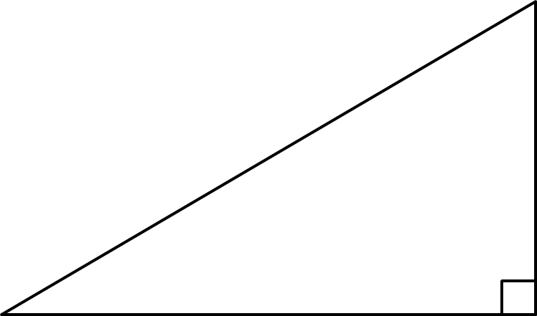
Topic: Pythagoras’ Theorem
EQ: How can I use Pythagoras’ Theorem to solve missing side lengths of a triangle?
To recap:
What is a right-angled triangle?
A right-angled triangle is a triangle with one angle that is 90º.
c
a
b
What is the rule for the sides?
The long side is called the hypotenuse. We can label this side as ‘c’ and the other sides as ‘a’ and ‘b’.
a² + b² = c²
This is called Pythagoras’ Theorem
Summary:

Slide 5
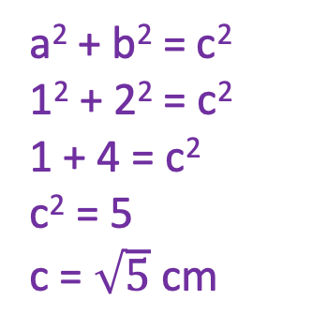
Topic: Pythagoras’ Theorem
EQ: How can I use Pythagoras’ Theorem to solve missing side lengths of a triangle?
Pythagoras’ Theorem
a² + b² = c²
c
a
b
How do we use PT to find the hypotenuse?
c
Example:
1cm
2cm
Step 1: Write the equation
Step 2: Rewrite it using the values we know
Step 3: Solve for the unknown
a² + b² = c²
1² + 2² = c²
1 + 4 = c²
c² = 5
c = $\sqrt{5}$ cm
If we need the exact value we can leave the answer in surd form (leaving the square root sign). Otherwise, calculate to 2 d.p.
Notes:
It’s worth mentioning to our students that they don’t get caught up blindly following the formula and thinking a, b and c will always be the same on every triangle. A could be the hypotenuse in one question.

Slide 6


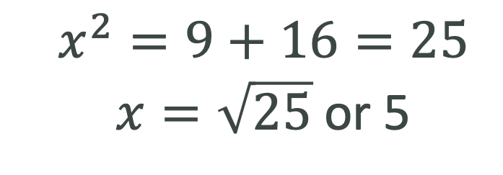
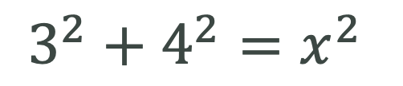

Let’s Try this Together
Step 1: To work out the hypotenuse.
Reveal >
$$x$$
$$3$$
Step 2: Form an equation
?
$$3^{2}+4^{2}=x^{2}$$
The hypotenuse appears on its own.
$$4$$
Step 3: Solve the equation to find the unknown side.
$$x^{2}=9+16=25$$ $x=\sqrt{25}$ or 5
?

Slide 7





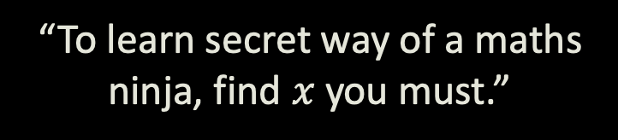


Test Your Understanding
2
?
Answer: $x=10$
42
1
?
Answer: $x=\sqrt{2}$
$$x$$
3
$$x$$
6
1
1
55
$$x$$
8
?
Answer: $x=\sqrt{4789}$
“To learn secret way of a maths ninja, find $x$ you must.”

Slide 8
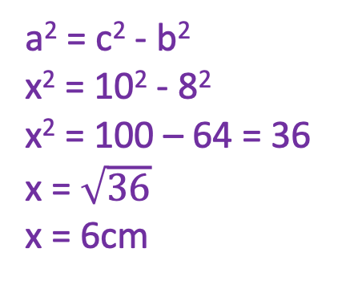
Topic: Pythagoras’ Theorem
EQ: How can I use Pythagoras’ Theorem to solve missing side lengths of a triangle?
Pythagoras’ Theorem?
a² + b² = c²
c
a
b
How do we use PT to find a shorter side?
To work out a shorter side, rewrite the formula as: a² = c² - b²
Example:
Step 1: Write the equation
Step 2: Rewrite it using the
values we know
Step 3: Solve for the unknown
a² = c² - b²
x² = 10² - 8²
x² = 100 – 64 = 36
x = $\sqrt{36}$
x = 6cm
10cm
x
8cm
Notes:
Again, make sure students know a and b are interchangeable if they’re representing the shorter sides: It’s the missing shorter side squared = the hypotenuse squared – the given shorter side squared.

Slide 9

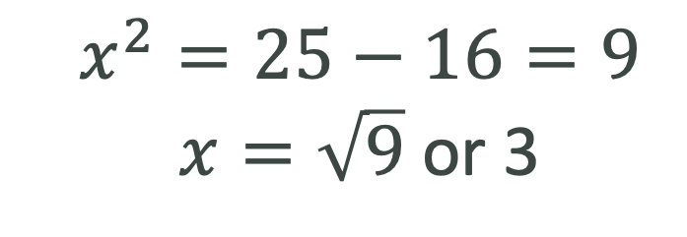
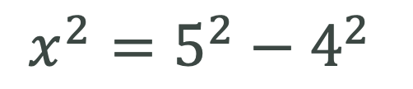

Let’s Try this Together
Step 1: To work out the shorter side.
Reveal >
$$5$$
$$x$$
Step 2: Form an equation
?
$$x^{2}=5^{2}−4^{2}$$
The shorter side appears on its own.
$$4$$
Step 3: Solve the equation to find the unknown side.
$$x^{2}=25−16=9$$ $x=\sqrt{9}$ or 3
?

Slide 10
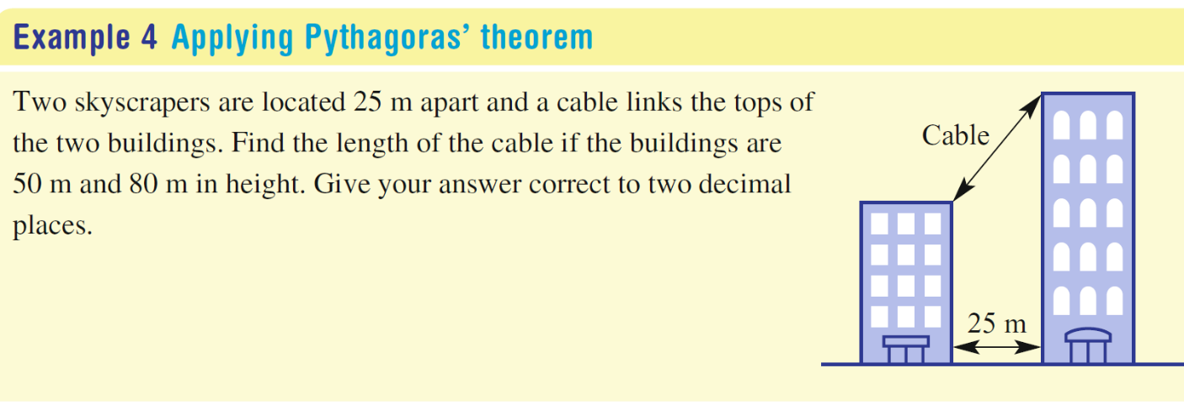
Topic: Pythagoras’ Theorem
EQ: How can I use Pythagoras’ Theorem to solve missing side lengths of a triangle?
How can we use PT to solve worded problems? What are the steps?
Draw a diagram to help identify the right-angled triangles that may help solve the problem.
Label the sides with their lengths. Use a pronumeral if the length is not unknown.
Use Pythagoras’ Theorem to work out the unknown.
Solve the problem by making any further calculations and answering in words.

Slide 11
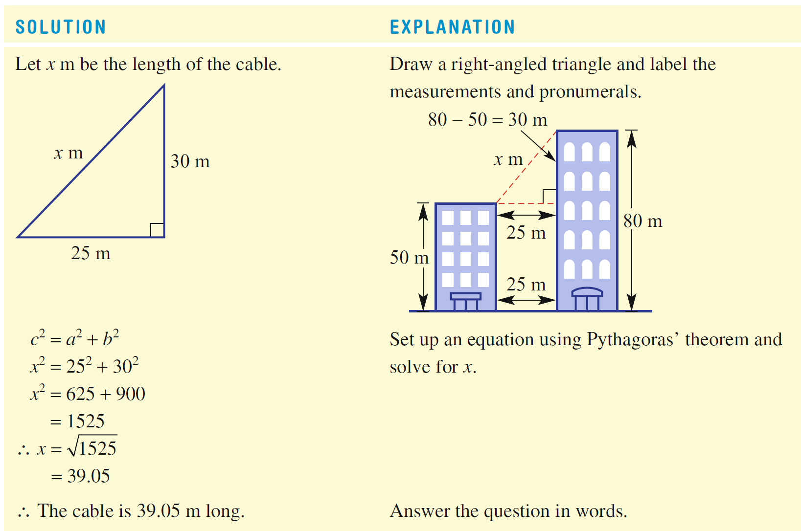

Slide 12

Practice
Introducing Pythagoras Worksheets
Notes:
Independent practice

Slide 13
Exit ticket
Write a summary answering the essential question.
Add at least three new terms to your glossary

